Slide 1
FEMA Declared Disasters and their Mitigation
By:
Himanshu Parashar,
Satwant Singh

Slide 2
Contents
Introduction
Target Audience
Data Integration
Data Visualization
Success
Issues faced
Summary

Slide 3
Introduction
Project aims to provide information about FEMA declared disasters since 1964 and their mitigation programs.
2 different datasets are mashed up and queried to generate results as per user requirement.
JQUERY , AJAX, Sgvizler and Google Visualization API is used for visualization.
SPARQL is used for querying
Apache Fuseki – The SPARQL Server used.
The user is provided with information about FEMA “Hazard mitigation program” declared disaster with details like Title, incident begin date, incident end date, funds granted, status of the program and the State or region.
User will graphically see the state wise allocation of funds.

Slide 4
Target Audience
The project focuses to provide aid to anyone who wants information or analyze FEMA disasters which were declared in “Hazard Mitigation program”.
Criteria includes: Incident begin date, incident end date, Funds allocated, status of the program, State wise funds allocation
Criteria clearly points to Disasters and their status along with funds allocated to them
Eg:
A reporter looking for information about FEMA declared disaster and their mitigation program state wise or wants to study pattern statewise.
An NGO wants to follow FEMA activities in disaster mitigation and their programs in various states
An individual gathering information about disaster occurrences, their states and their status.
They can find and analyze if any particular state lacks some facility or is more dependent on FEMA or if a particular state receives more funds or suffer more loss (may be due to more people and infrastructure).

Slide 5
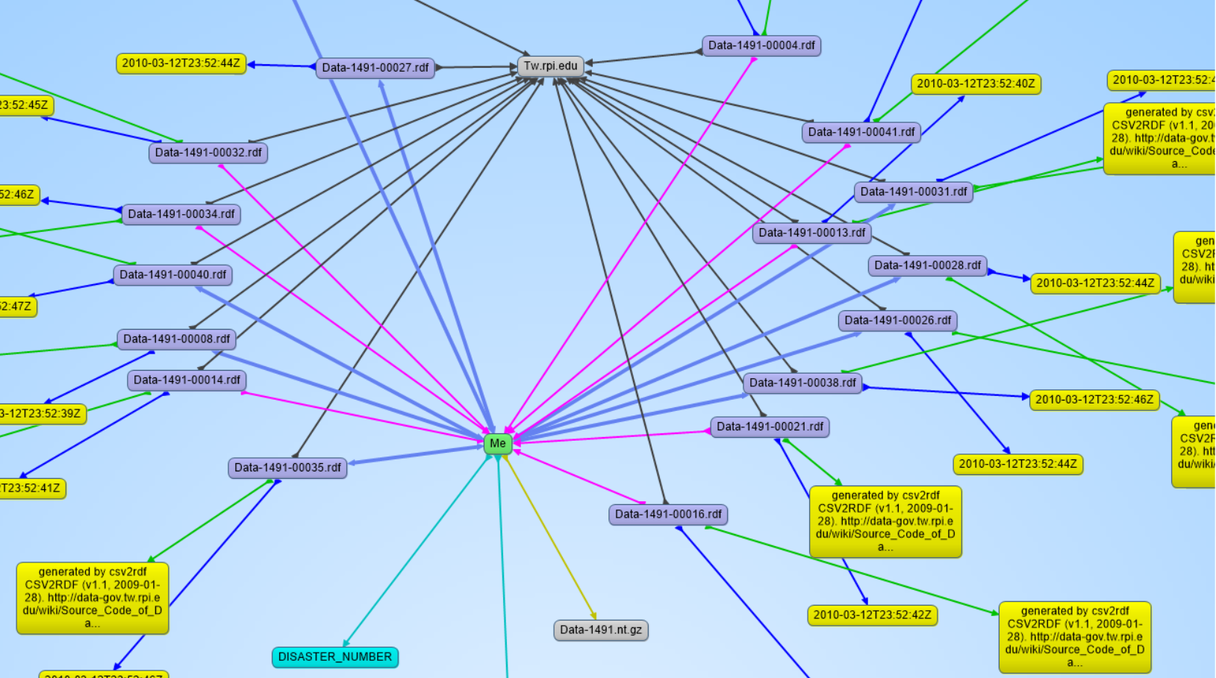
Data Description
Dataset 1491: FEMA Disaster Declarations summary
Attributes used: disaster number, incident begin date, incident end date.
Number of triples: 538,433 Number of entries: 37,059

Slide 6
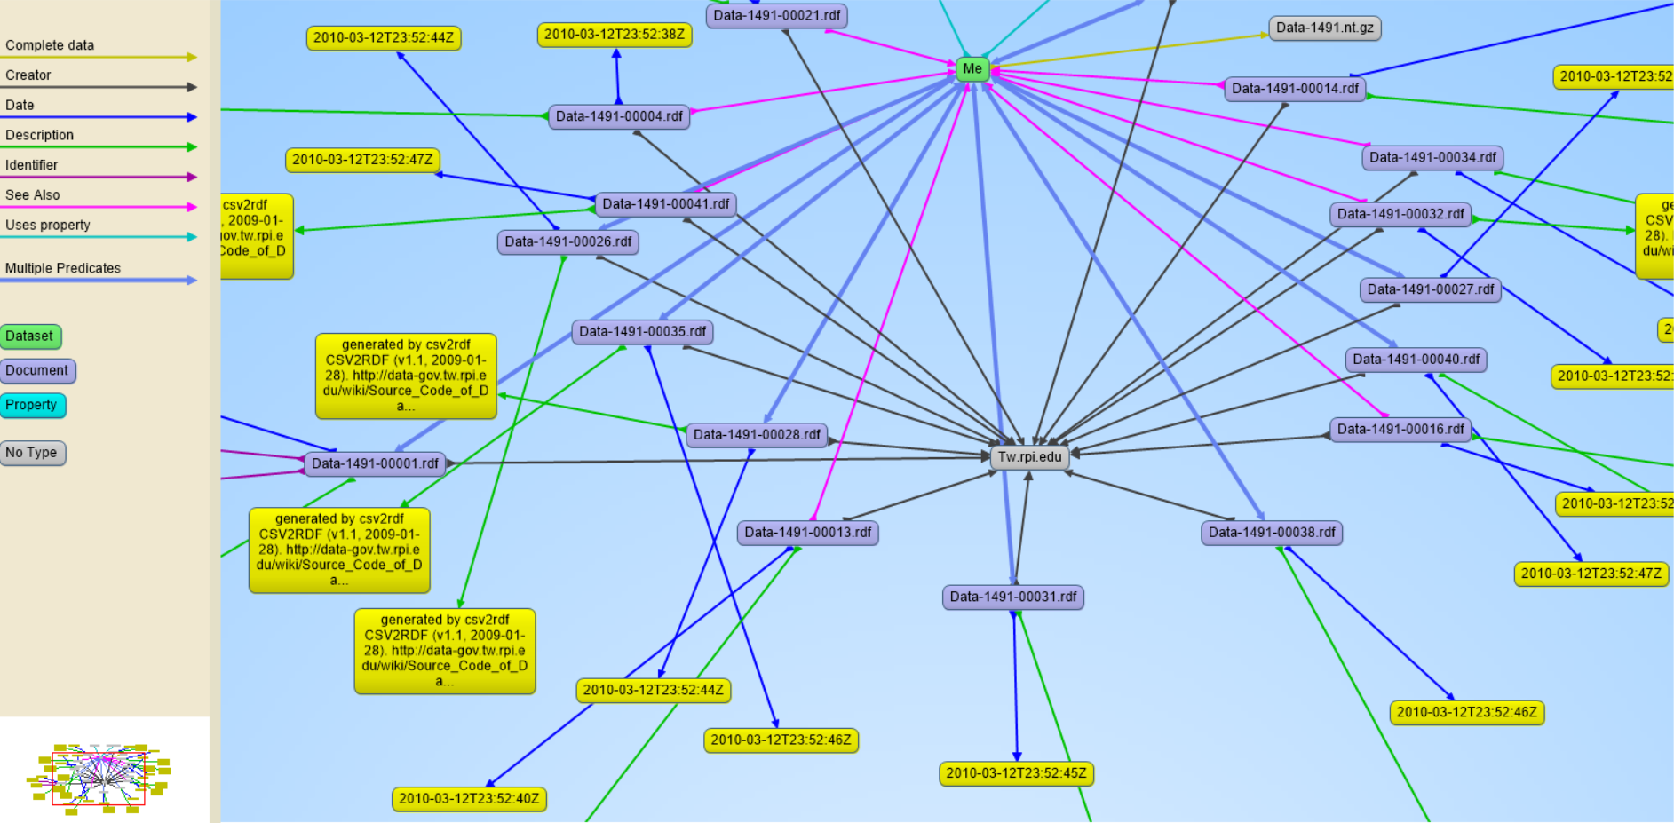
Data Description
Dataset 1493: FEMA Hazard Mitigation Program Summary
Attributes used: disaster number, title, state, funds granted, status.
Number of triples: 280,055 Number of entries: 16,783

Slide 7
Data integration
Both the data sets has a common attribute – disaster number.
Disaster_number - http://data-gov.tw.rpi.edu/vocab/p/1493/disaster_number is used to mash up both the data sets or graphs
Queries on the datasets –
Dataset 1491: querying for following information – Disaster number, Incident begin date, incident end date
Dataset 1493: querying for following information – Disaster number, title, state, status, project amount, project description

Slide 8

Data Visualization
Along Sgvizler and Google Visualization API was used to create a tabular representation of FEMA mitigation program details and chart for state vs allocated funds.
The end result also provides the pie chart of state vs funds allocation and table to see all the FEMA mitigation program information like Title, incident begin date, incident end date, disaster number, state or region, funds allocated, status and program description.

Slide 9
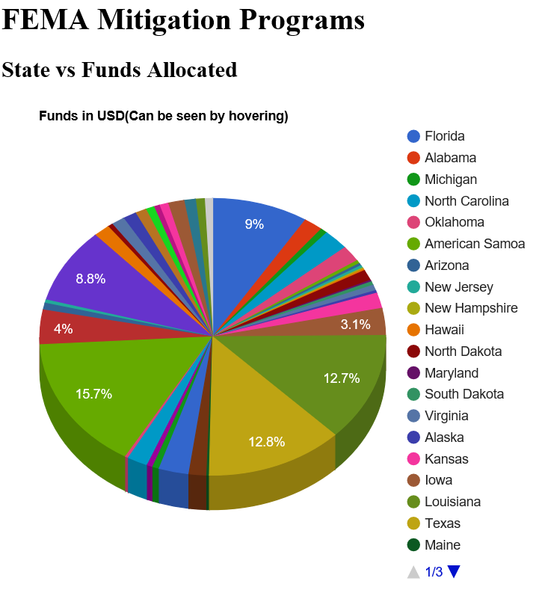
Data Visualization
Pie Chart

Slide 10
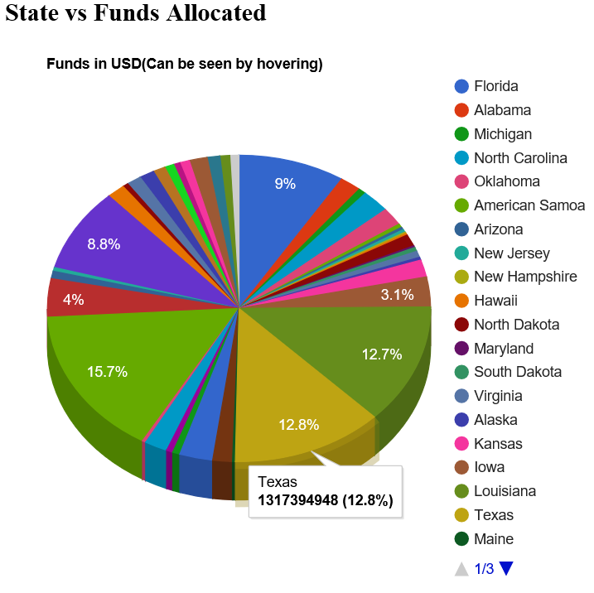
Data Visualization
Hover and see the funds(in USD) for a particular state/region

Slide 11
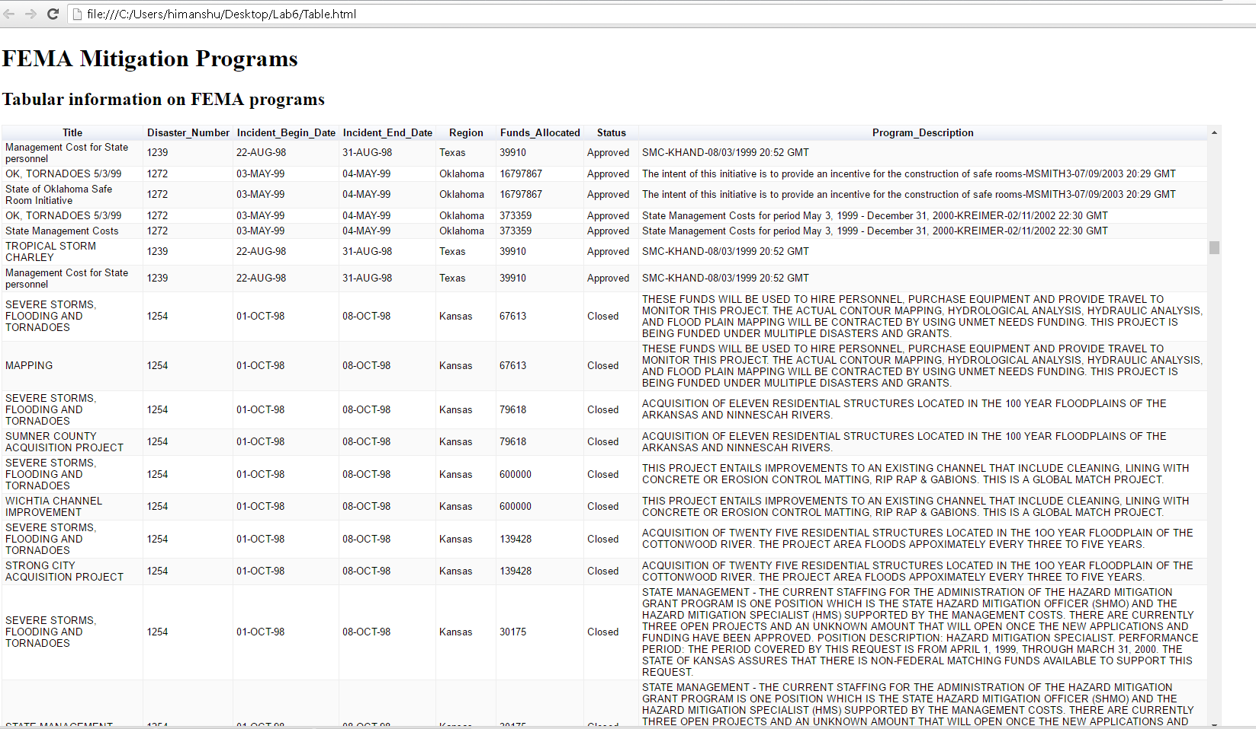
Visualized data (Tabular form) with FEMA mitigation program details

Slide 12

Success
Earlier, goal was to see the raw triple data and check/analyze the data based on it.
Now, user can visit the links (HTML files) and see the graphical chart of state vs funds and also the table to see all the relevant information about the FEMA disasters.
Provides greater flexibility to user, much more interactive
User can easily go to link and check all the information and details.

Slide 13

Issues Faced
Creating SPARQL end point since it was not present on LOGD website
For google API visualization of the result, the end point was local so data was not getting rendered.
Large data (large number of triples to be queried and inserted on our visualized tables and graph)
SPARQL aggregate query since we need sum of all funds for all programs initiated by FEMA in every state

Slide 14

Summary
The datasets were mashed up successfully on common attributes.
User is provided with links and easy visualizations to compare data and information
The application enumerates desired results.

Slide 15
References/Citations
Martin G. Skjæveland. Sgvizler: A JavaScript Wrapper for Easy Visualization of SPARQL Result Sets. In: 9th Extended Semantic Web Conference (ESWC 2012), workshop and demo proceedings. Heraklion, Crete, Greece, 2015.

Slide 16

Thank You…!!!

